Slide 1

Introduction to the Careers Service
PAUL MCLENNAN
Careers Adviser

Slide 2

AIMS
Introduce the Careers Service
To explain the role of the Careers Adviser
What to expect in Year 12
Get you thinking!

Slide 3
THE CAREERS SERVICE
Part of Department for The Economy (DFE)
Located throughout NI
Deliver careers information, advice and guidance
All age guidance service

Slide 4
ROLE OF THE
CAREERS ADVISER
We provide information, advice and guidance to help individuals make informed decisions about their future options regarding:-
  Education
  Training
  Employment
We deliver an impartial careers information, advice and guidance programme to complement your careers education in school

Slide 5
YEAR 12
PROGRAMME
Application for Careers Guidance
Careers Guidance Interviews From October By Phone.
Career Information by email.

Slide 6
WHAT to think about when you’re in year 12.
What are the choices?
Continuing with Education – A Levels, Vocational & Applied A Levels, National Diplomas / school/ alternative school / college
Getting some Training- Traineeships / Apprenticeships
Getting a Job ?

Slide 7
DECIDING ON THE BEST OPTION
YOURSELF
Your Strengths / weaknesses
WHAT YOU HOPE TO ACHIEVE IN THE SHORT/ LONG TERM
WHAT ARE YOUR GCSE RESULTS LIKELY TO BE?
WHETHER YOUR SKILLS ARE IN ACADEMIC OR PRACTICAL AREAS ( OR A MIXTURE OF THE TWO)
Are you considering university / Higher Education longer term?

Slide 8
https://www.economy-ni.gov.uk/publications/ni-skills-barometer
NORTHERN IRELAND SKILLS BAROMETER

Slide 9
Top 10 Growth Sectors
2016-2026
Notes:
Top 10 growth areas:
Professional, scientific & technical
ICT
Admin & Support Services
Health & Social Work
Manufacturing
Construction
Restaurants & hotels
Arts & Entertainment
Finance & Insurance
Transport & Storage

Slide 15
Top 10 Growth Sectors
Professional, Scientific & Technical
ICT
Admin & Support Services
Health & Social Work
Manufacturing
Construction
Restaurants & hotels
Arts & Entertainment
Finance & Insurance
Transport & Storage
Notes:
Show Source – Skills in Demand Booklet produced by Department for the Economy and Ulster University

Slide 16
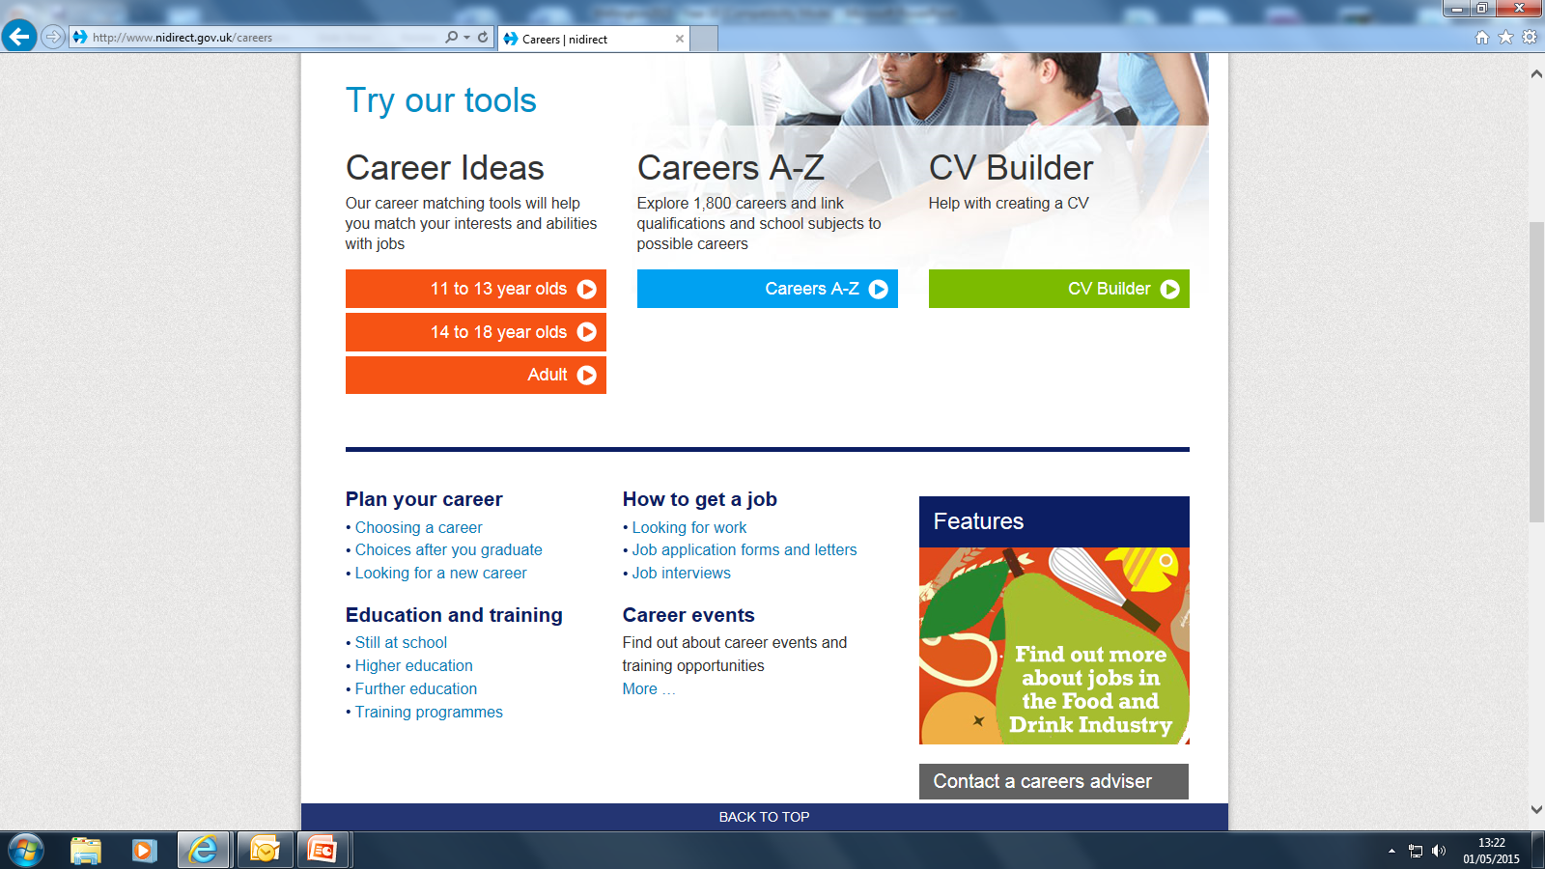

Slide 17
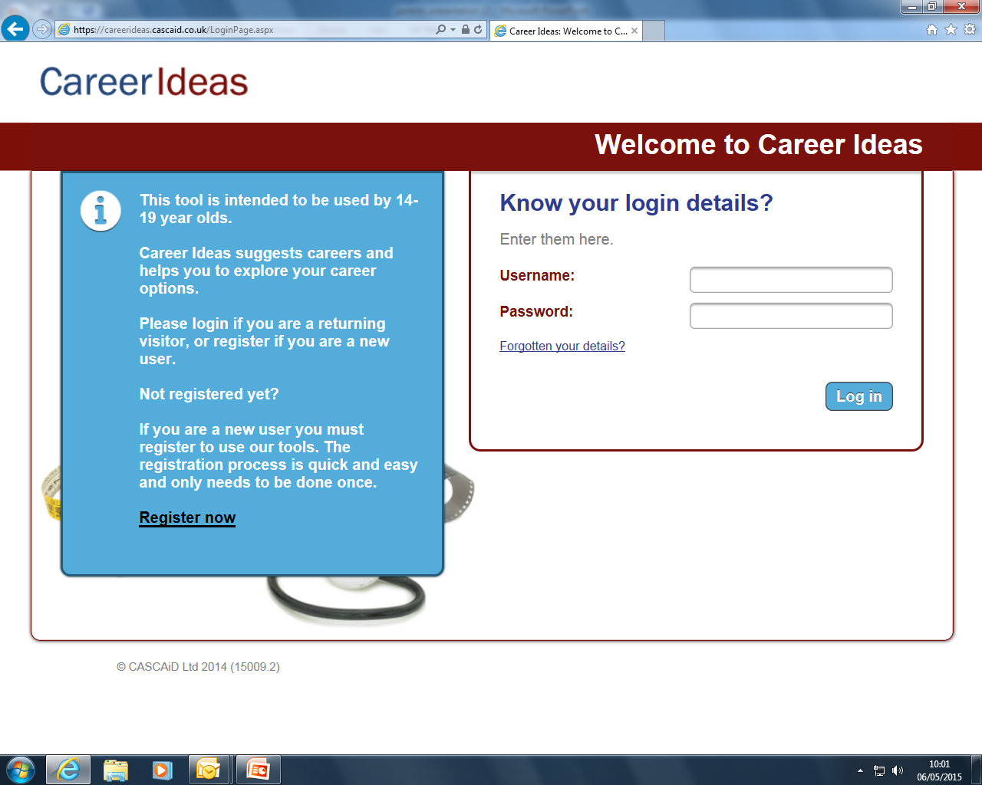

Slide 19
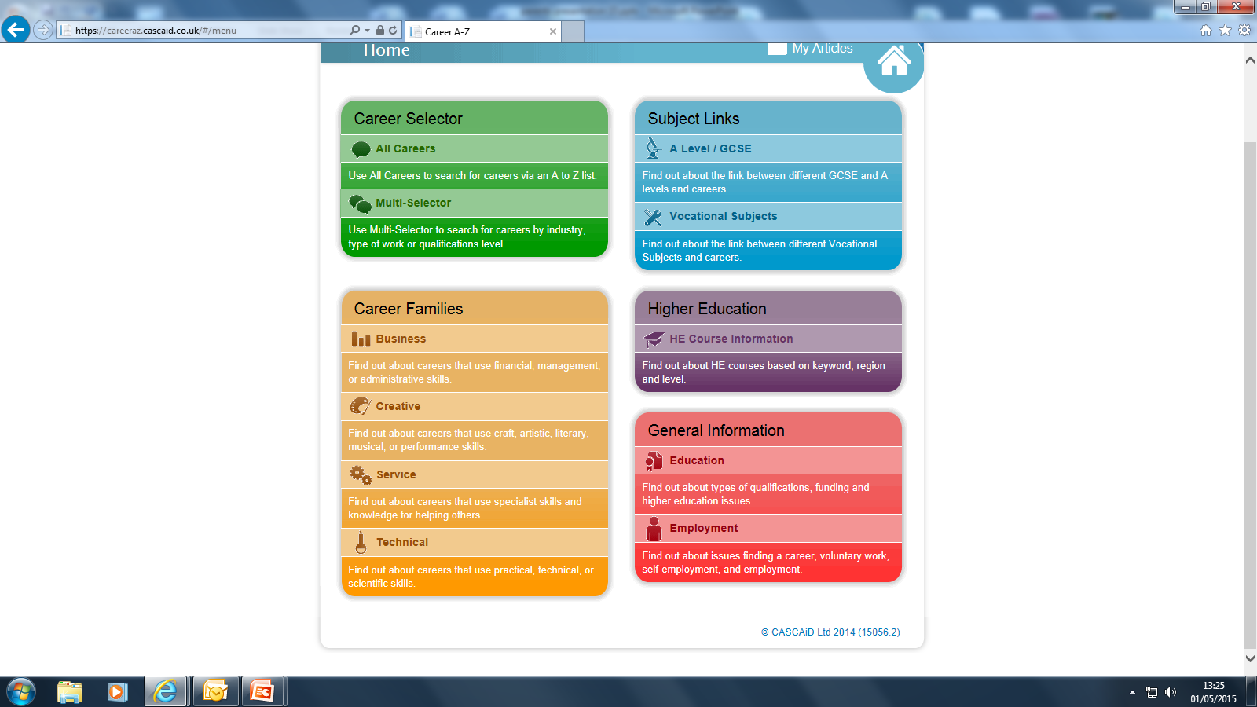

Slide 21
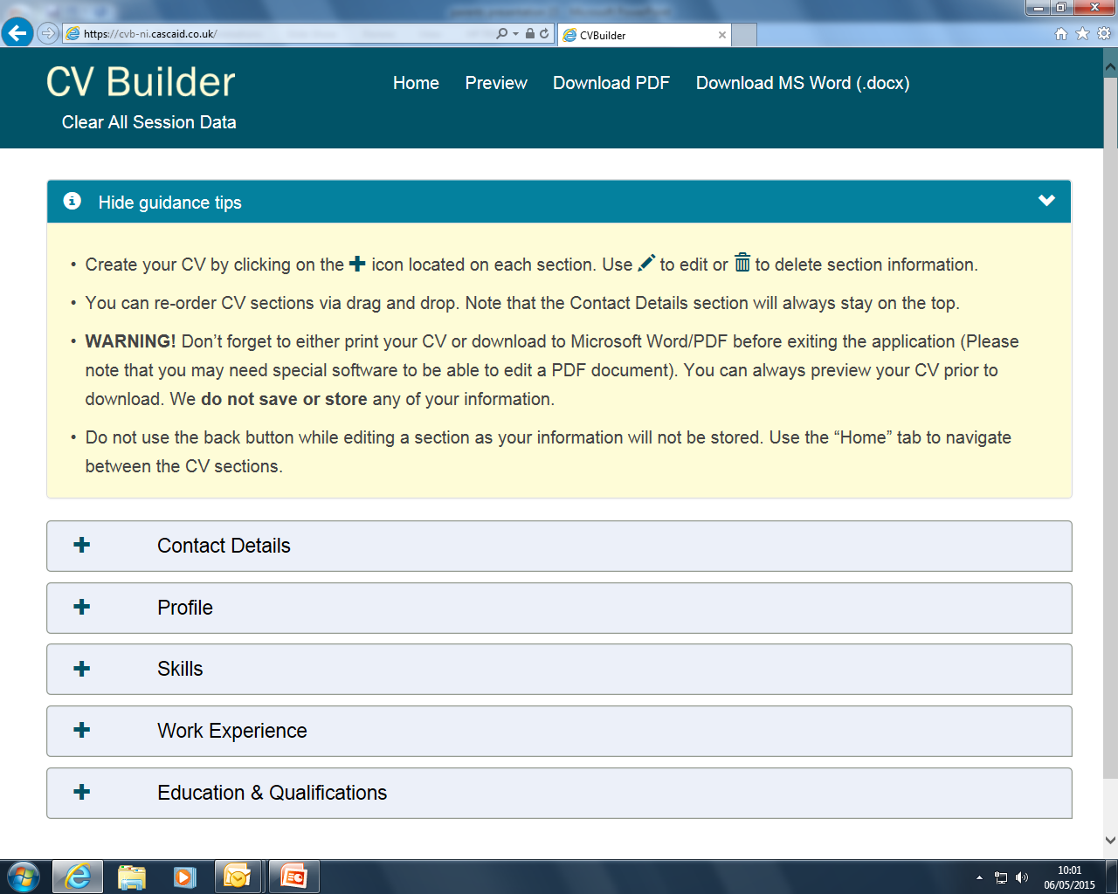

Slide 22
Need more information
Use your careers library in school
Speak to family and friends
Speak to your Careers Adviser and Careers Teacher
Do research on the internet:
Attend Virtual open days

Slide 23
LINKS
More information about professional careers and training can be found on the following websites
www.nidirect.gov.uk/campaigns/careers
www.totalprofessions.com
www.prospects.ac.uk
www.qub.ac.uk/Discover/Visit-Us
www.ulster.ac.uk

Slide 24
LINKS
If you have some career ideas already, you should check entry requirements in related degree subjects on the UCAS Website in the Course Search Section. See also the Best Course 4 Me website for advice on careers and university courses.
www.nidirect.gov.uk/skills
Northern Ireland Skills Barometer - “Skills in Demand ...
https://www.economy-ni.gov.uk/publications/ni-skills-barometer

Slide 25

NEXT STEPS
Get your
thinking
hats on
Plan ahead
Research your
options
Use the resources
available

Slide 26
QUESTIONS…

